Slide 1
National Record Locator on the SCRa
Overview for Desktop
July 2020

Slide 2
Introduction
This slide deck contains a high level overview of how to use the NRL on the newly platformed Summary Care Record Application (SCRa). This deck is intended for the training and reference use of desktop users who are new or have transitioned from using the old SCRa.
This slide deck covers the following topics;
An introduction to the National Record Locator (NRL) Service
Logging on to the SCRa
Searching for patients
Viewing NRL pointers and retrieving available documents
Viewing patient SCRs and gaining permission to view (PTV)

Slide 3
NRL Introduction

Slide 4
The Vision:
The National Record Locator (NRL) is a national index of pointers to patient records. It enables an authorised clinician, care worker and/or administrator, in any health or care setting, to access a patient’s information to support that patient’s direct care.
The Principles:
The NRL integrates patient record access across the NHS and Social Care without dictating where those records might be stored, thus realising a level of national interoperability across the service which has previously been unachievable
NRL is NOT a central data store for patient records
It is an index that provides the location of records, the technical means to retrieve them, underpinned by an IG framework to safely support sharing on a national scale
Notes:
NRL has huge potential for a wide number of use cases and stakeholders.
However, the strategy is one of iterative development.
Each new release offers more functionality and benefit to a wider range of users.

Slide 5




NRL Overview
Patient record
Search NRL
Add Pointer
Retrieve Pointer
NRL
NRL Provider
NRL Consumer
NHS Spine
Request record
Return record

Slide 6


NRL enables cross border record sharing on a national scale
Lancashire Care
NRL is connecting local and regional sharing initiatives such as LHCRs, Shared Care Records, software supplier associations, and individual trusts, giving them a national presence
MENTAL HEALTH CRISIS PLAN
Patient lives in Preston
London Ambulance
Receive 999 call
Treat patient
Retrieve plan from Lancashire Care via the NRL
Patient travels to London
Requires emergency care and calls 999

Slide 7
NRL Stakeholders – Connected, In-progress (onboarding) and engaged

Slide 8
SCRa overview
Logging in and finding a patient

Slide 9
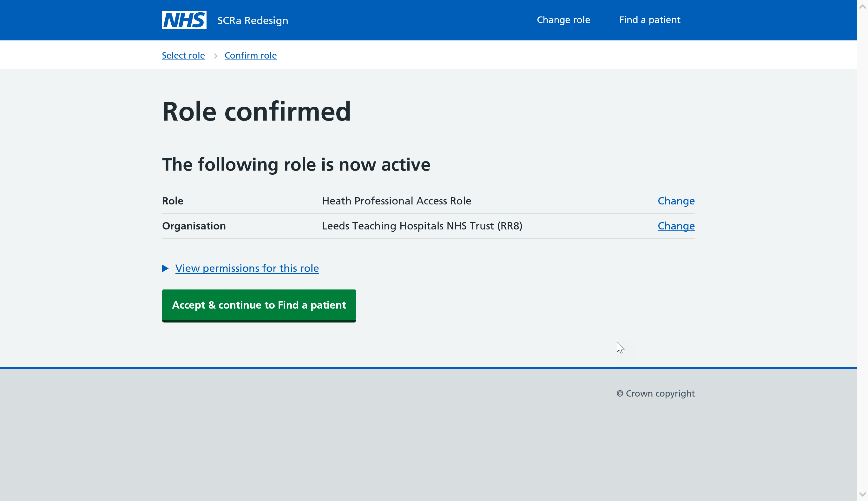

Logging on to SCRa
Once the user has entered their smartcard and passcode, the user should navigate the to new URL for the SCRa:
https://portal.spineservices.nhs.uk/kookaburra
A new logon step will then require the end user to confirm the role they wish to use for the current session in the browser window.
Once confirmed, the end user can continue using the green button
and will be taken to the ‘Find a Patient’ screen.

Slide 10
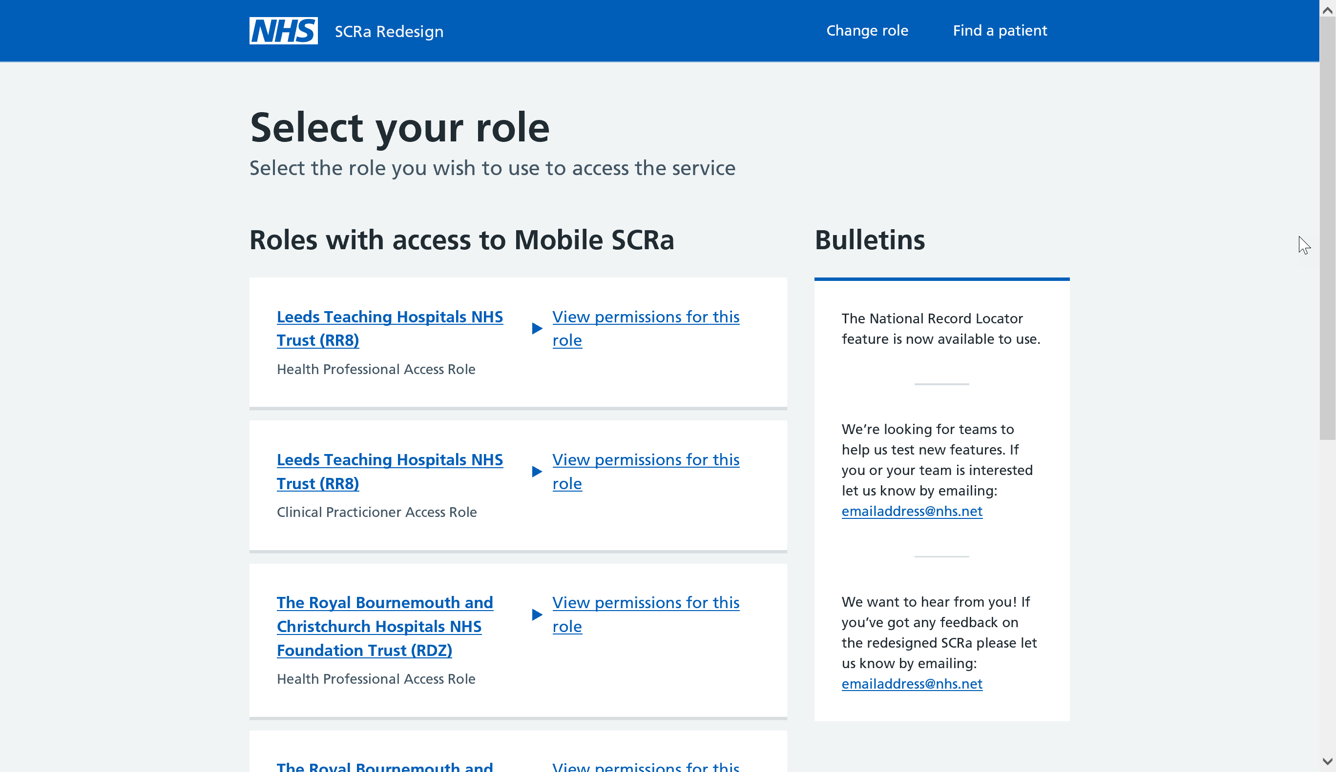

Slide 12
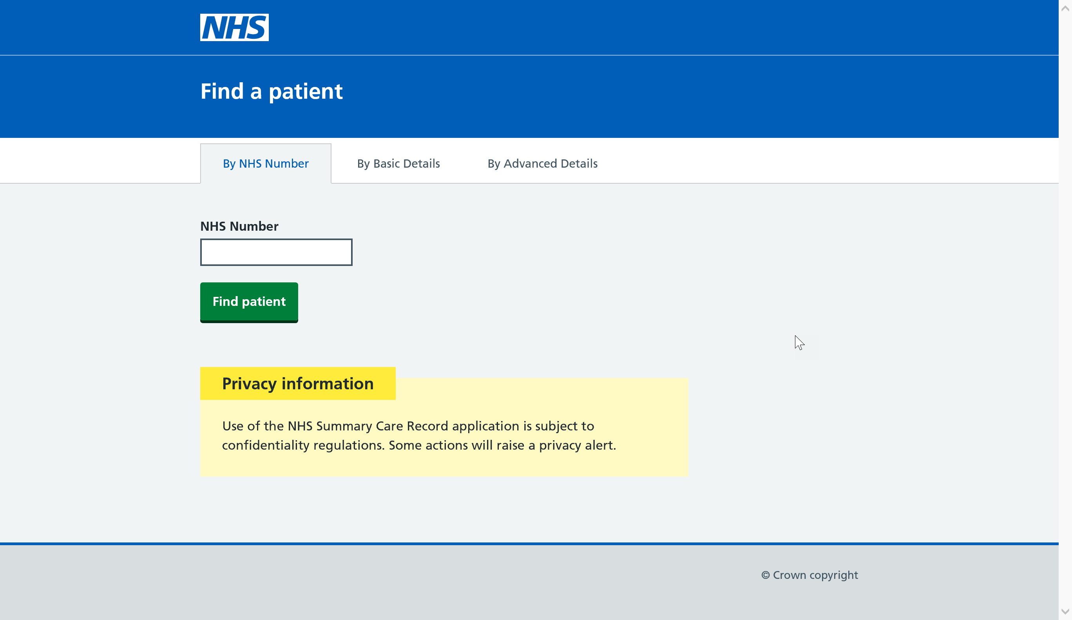

Slide 13
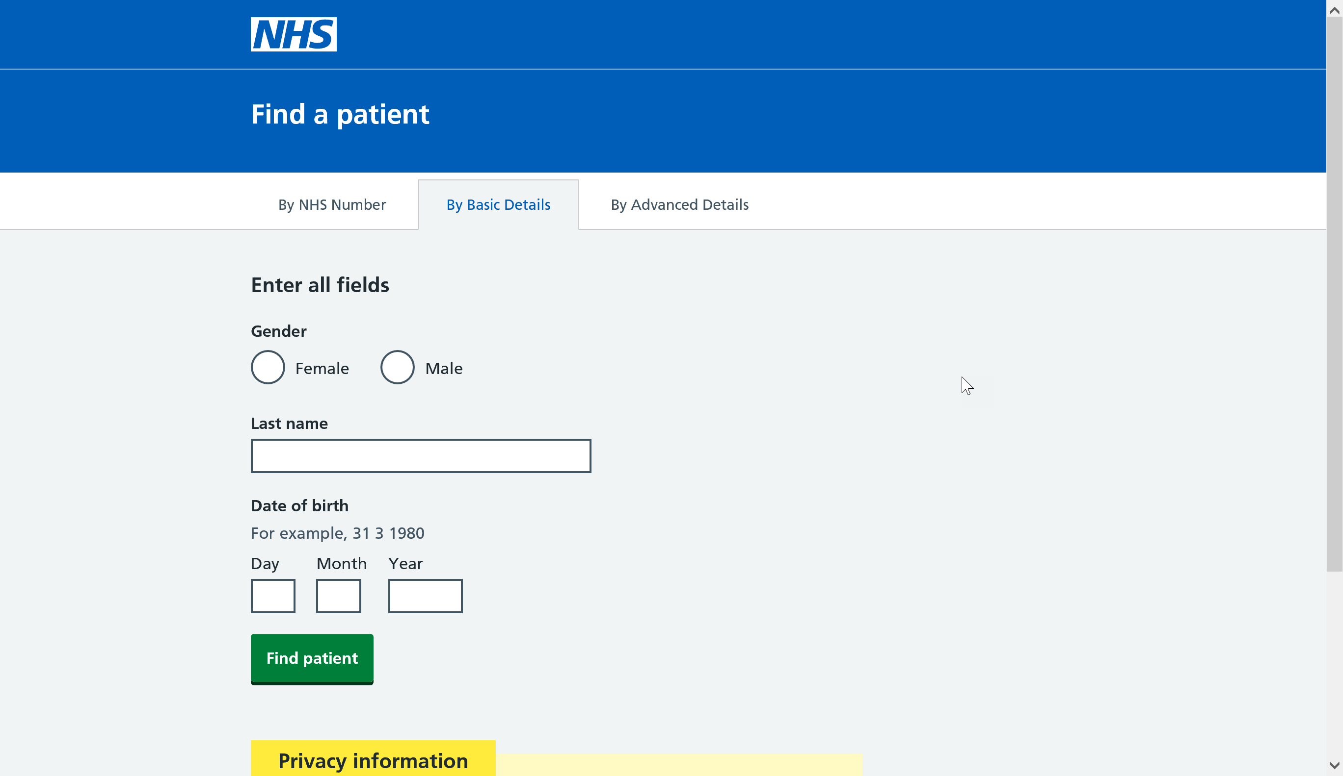

Slide 14
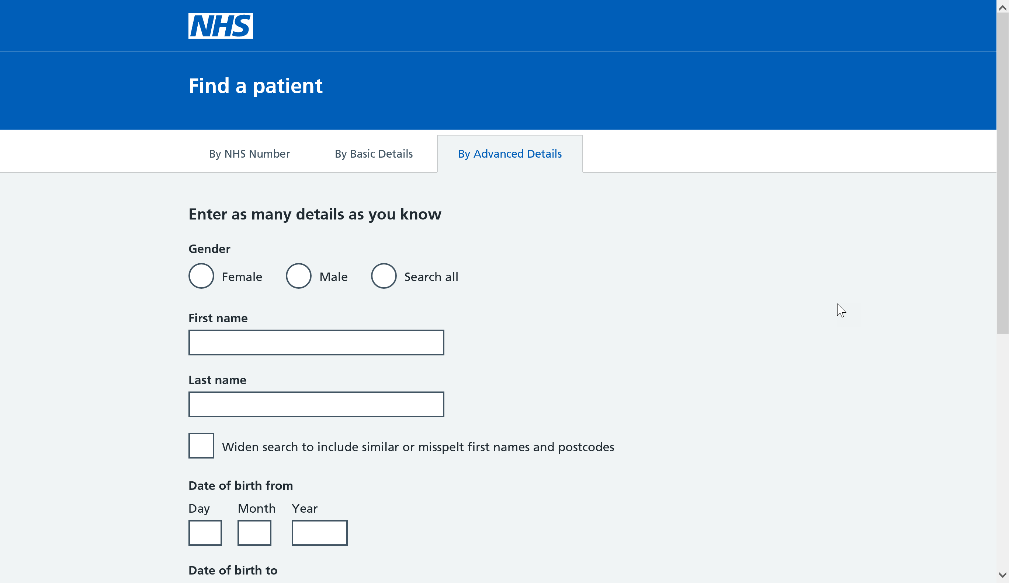

Slide 15
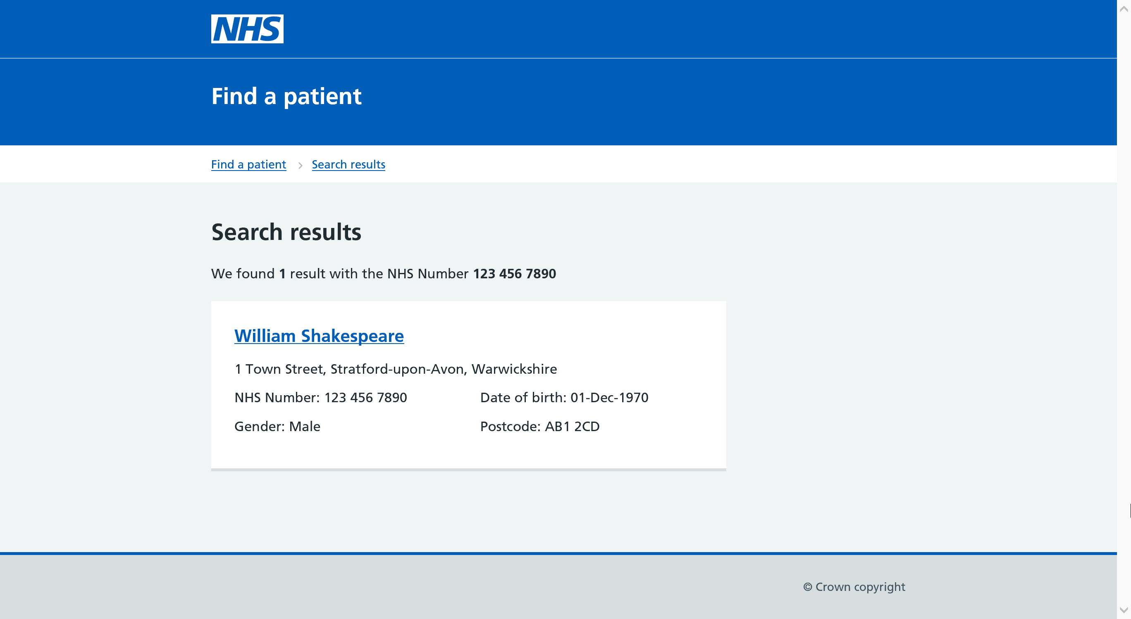

Slide 16
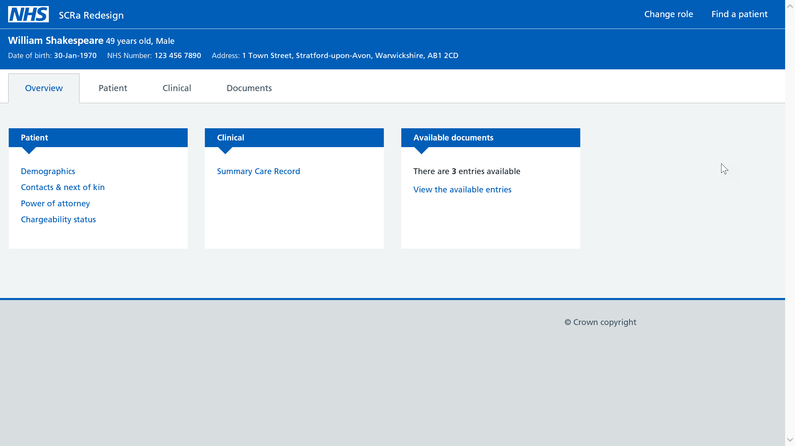

Slide 17
Accessing NRL on SCRa
End User Overview

Slide 18
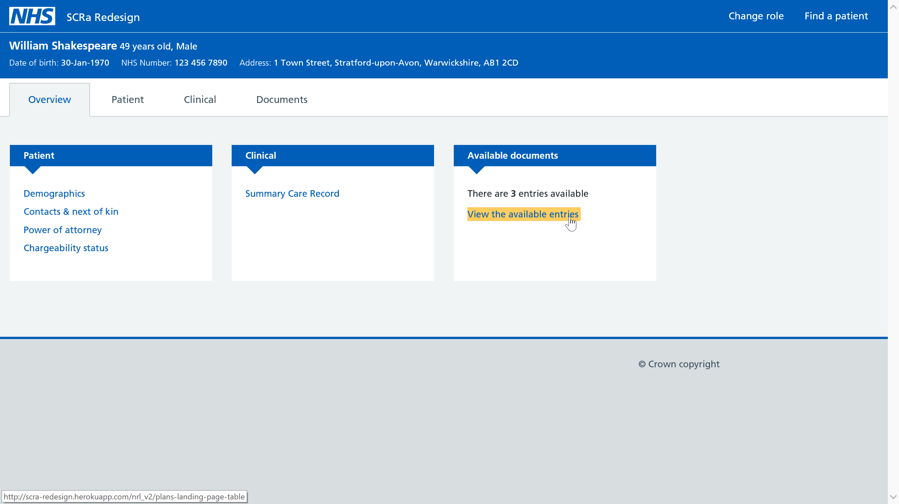

Slide 19
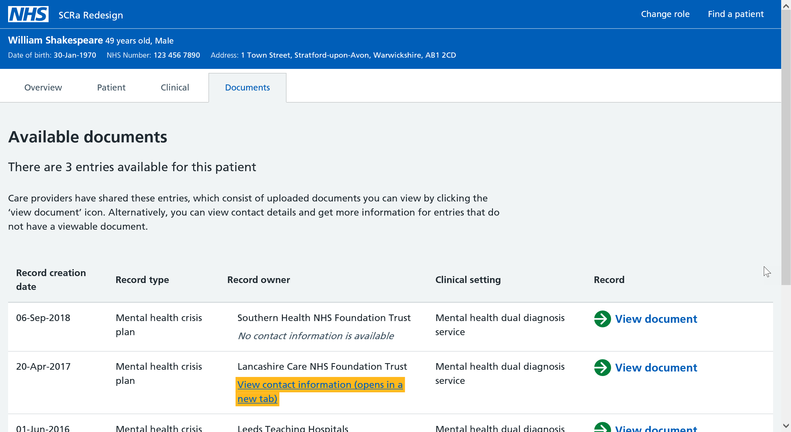

Slide 20
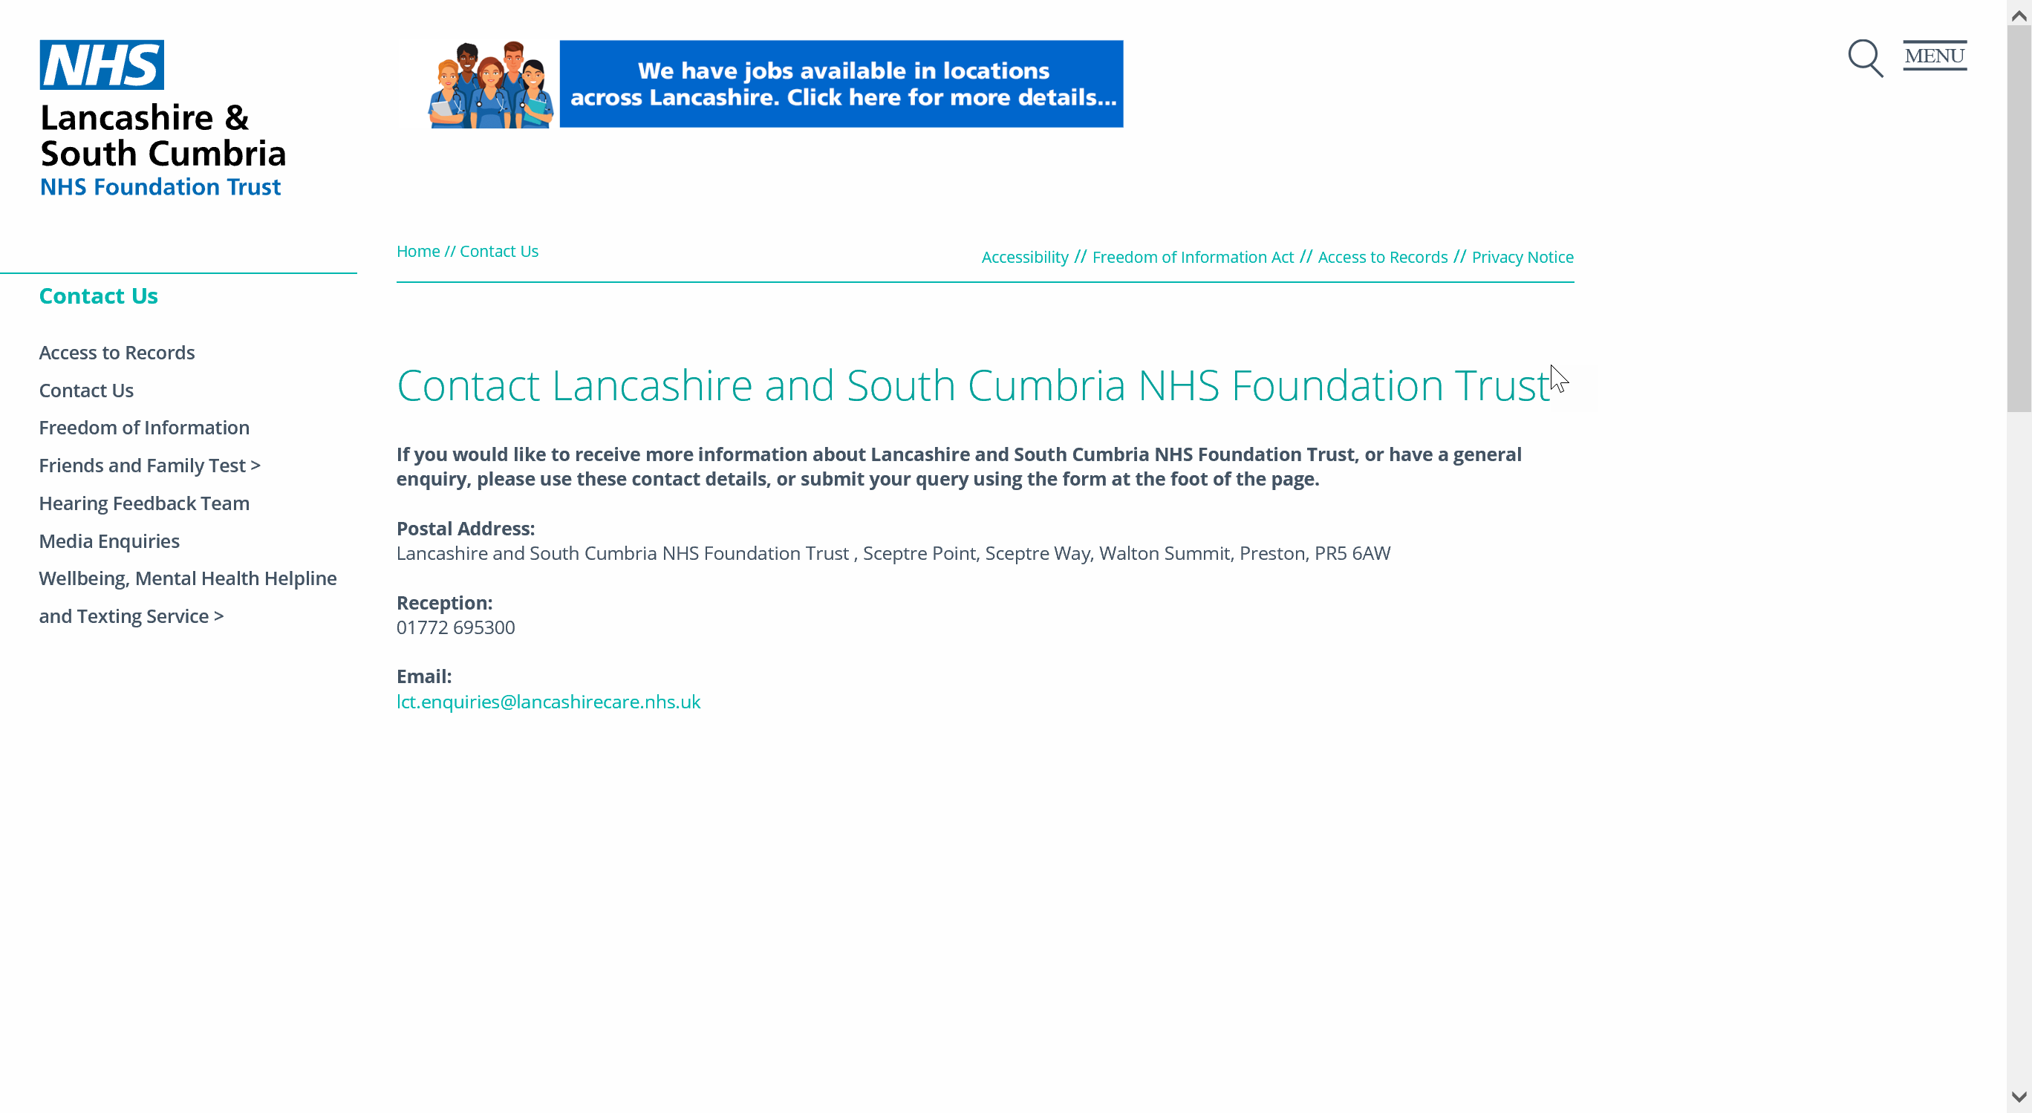

Slide 21
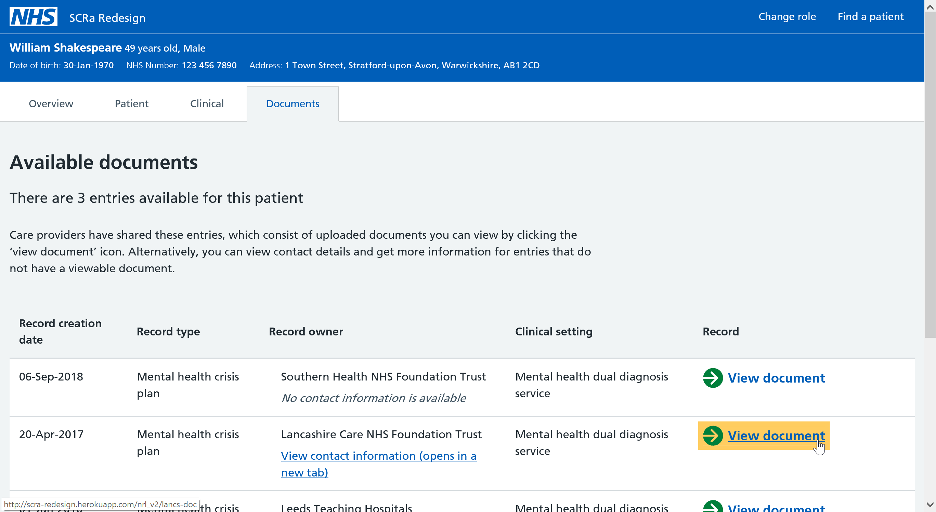

Slide 22
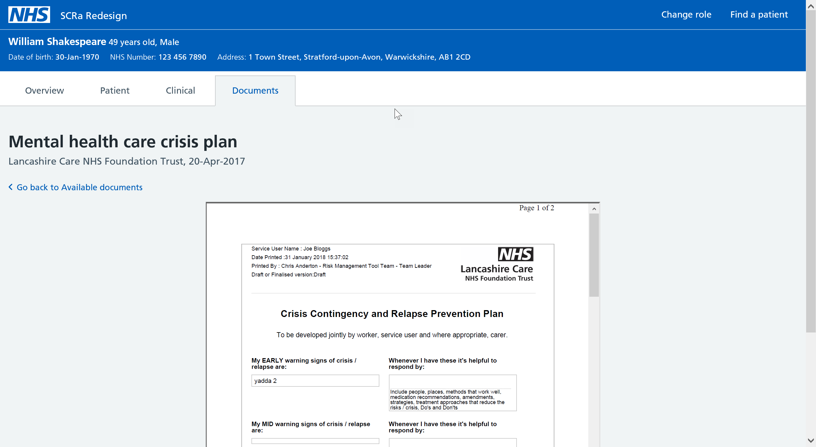

Slide 23
Summary Care Record
End user overview

Slide 24
Summary Care Record (SCR)
SCRs are an electronic record of key information from the patient’s GP practice, providing the only England-wide summary sharing solution.
All practices in England have uploaded their patients SCRs to the Spine.
SCRs provide authorised healthcare professionals treating patients in different care settings with faster access to key clinical information.
SCRs are optional, a patient can choose to have one or not and they can change their mind at any time by contacting their GP practice.
SCRs are only accessible with permission from the patient except for exceptional circumstances (e.g. emergency access, if the patient is unconscious).
The SCR is automatically updated in real time when the core data items in the GP record are updated and no other healthcare setting can update the SCR apart from the patient’s GP practice.

Slide 25












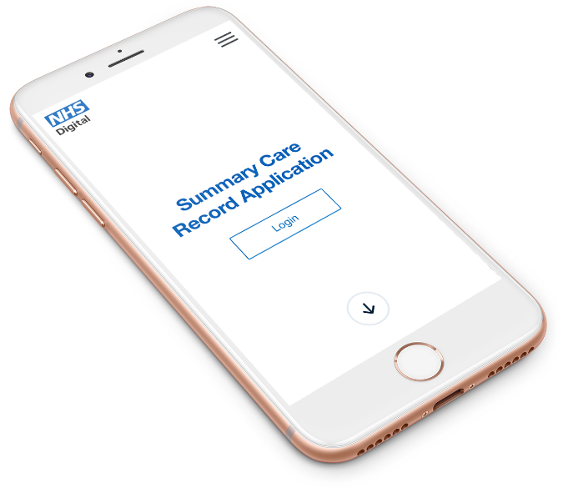

SCR Flow Diagram
& beyond
Patient choice & legal direction:
SCR Core
SCR with AI
SCR Opt out

Slide 26
What does the SCR contain?
Generally SCRs consist of the following core data items recorded in the GP record, these include;
Allergies and adverse reactions.
Acute medication – prescribed in last 12 months.
Repeat medication – all from the current practice.
Discontinued repeat medication – all meds stopped in the last 6 months.
Additional Information can also be added to the SCR with the patient’s express consent and includes: Reason for medication, significant medical history, anticipatory care information, communication preferences (SCCI-1605), end of life care information (SCCI-1580) and immunisations

Slide 27
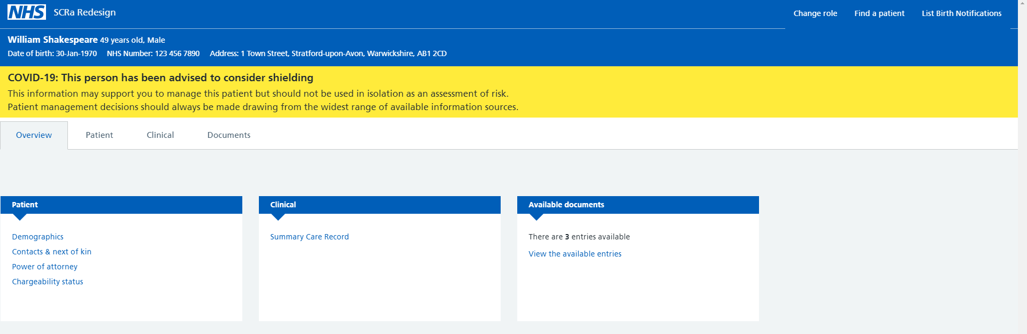
Shielding Patient List Dialog (if available)
This information may support you to manage this patient but should not be used in isolation as an assessment of risk. Patient management decisions should always be made drawing on the widest range of information sources.
Notes:
This is the image that will pop up in the SCRa each time a patient’s record is opened where the patient has been advised to consider shielding. It states ‘‘COVID-19 risk indicator flags are present. This person has been advised to consider shielding. This information may support you to manage this patient but should not be used in isolation as an assessment of risk. Patient management decisions should always be made drawing on the widest range of information sources.’
https://digital.nhs.uk/services/summary-care-record-application/summary-care-record-application-scra-shielded-patient-flag

Slide 28
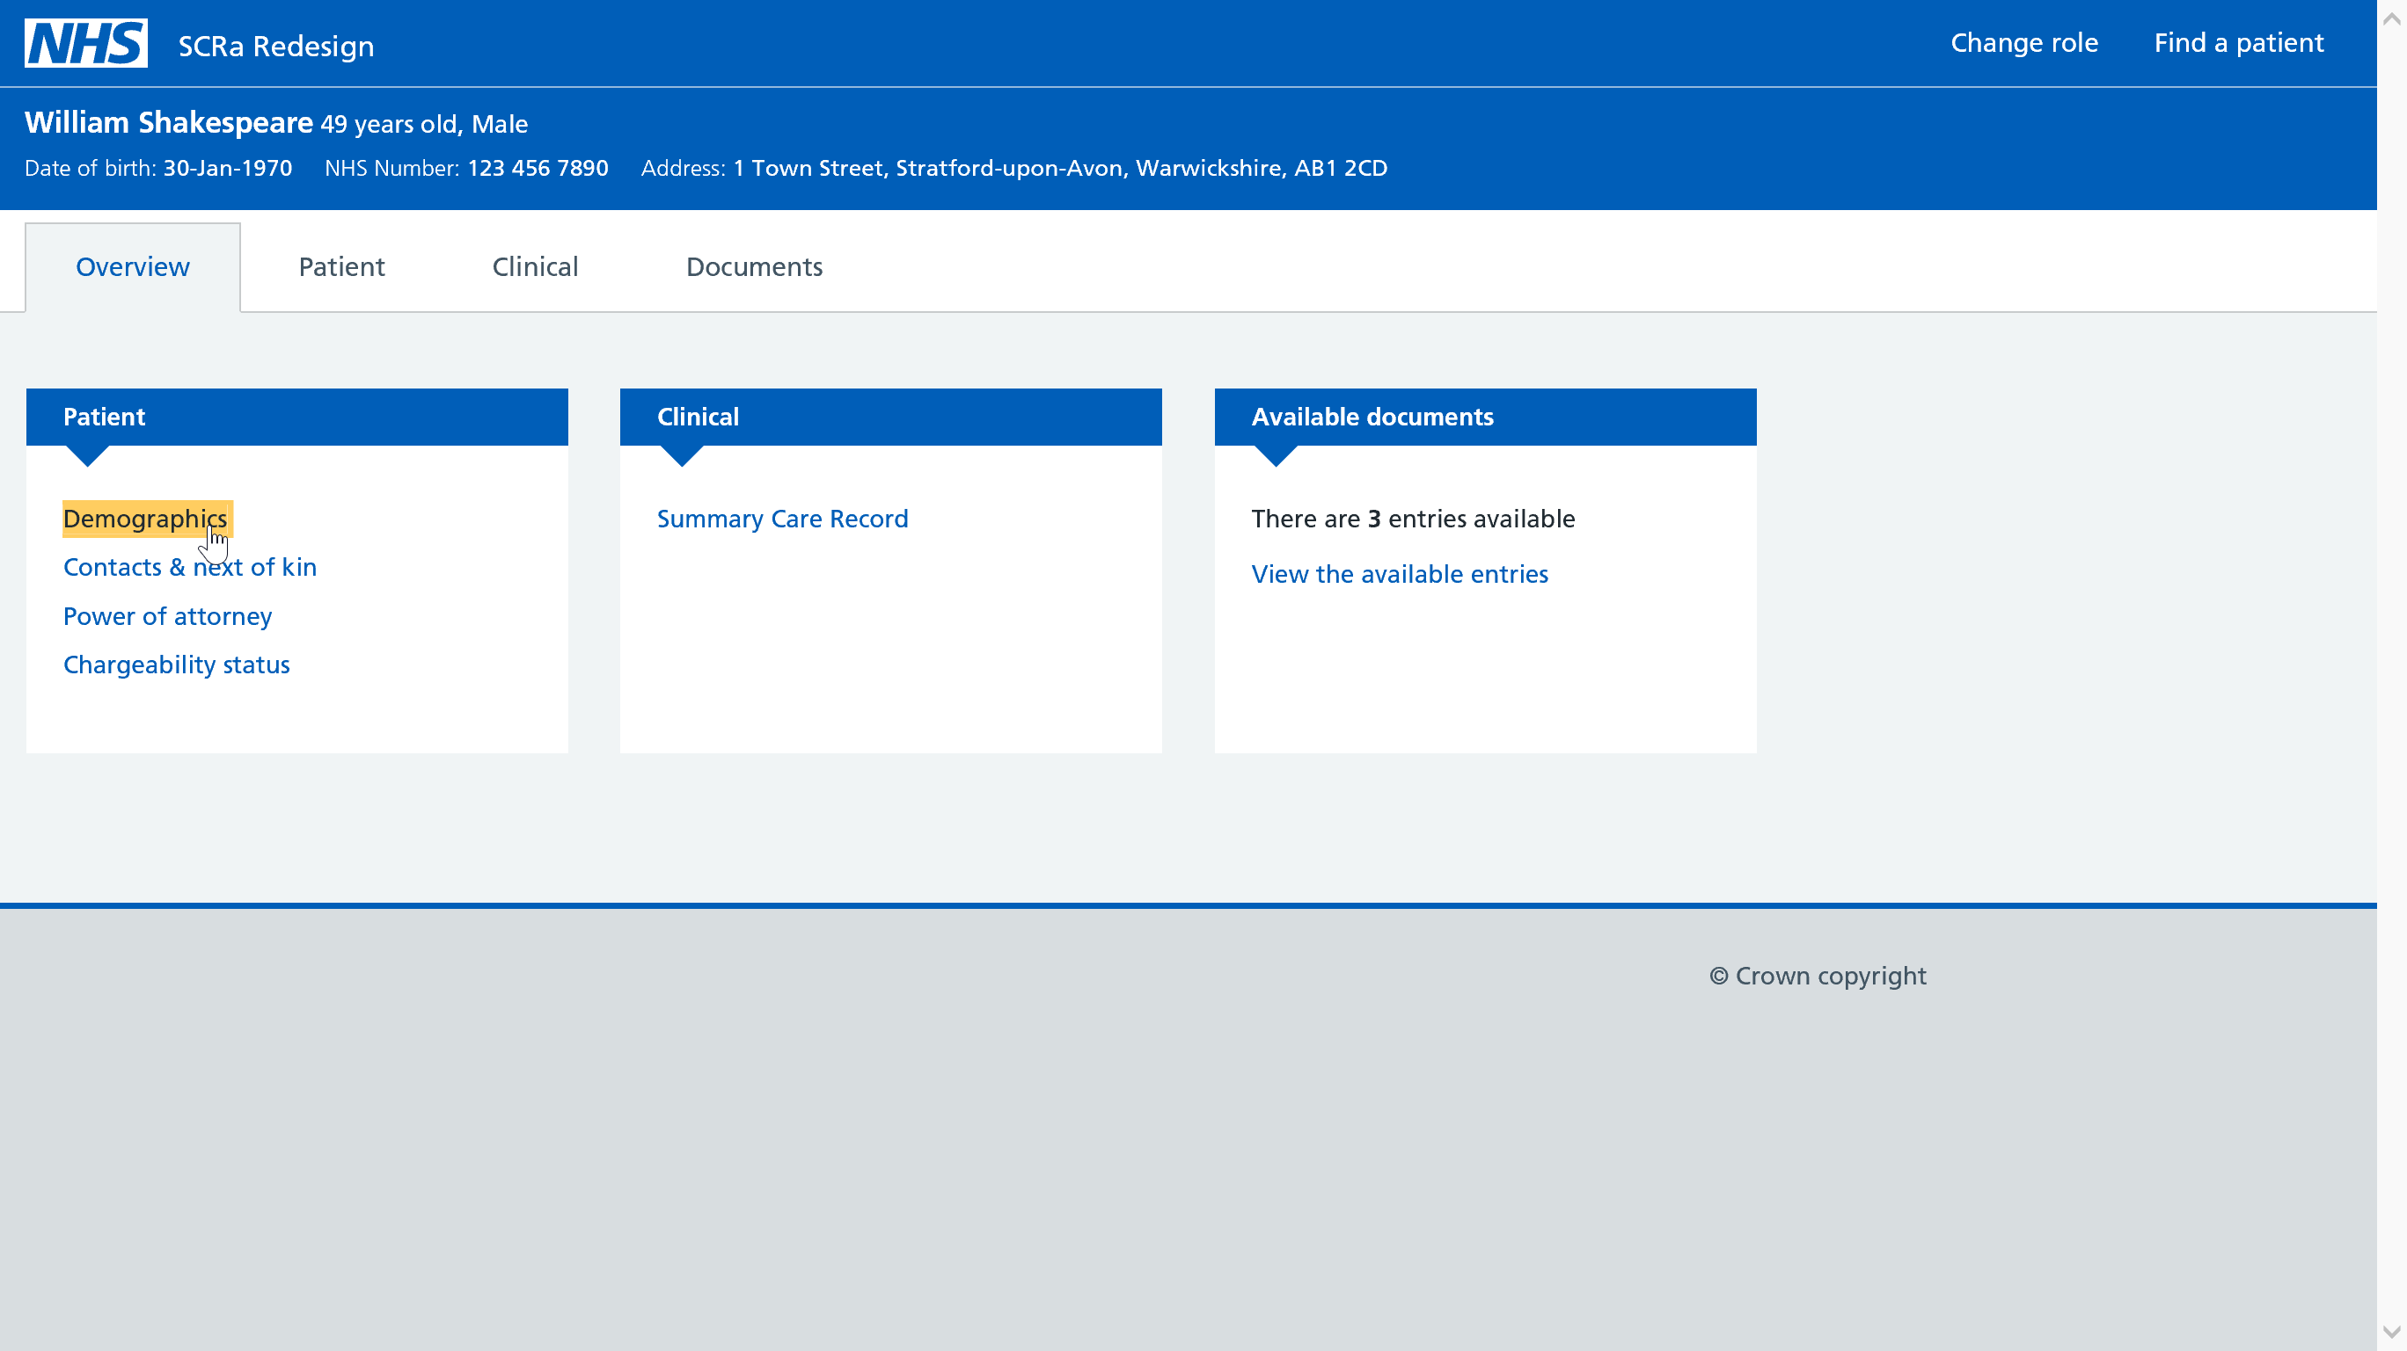

Slide 29
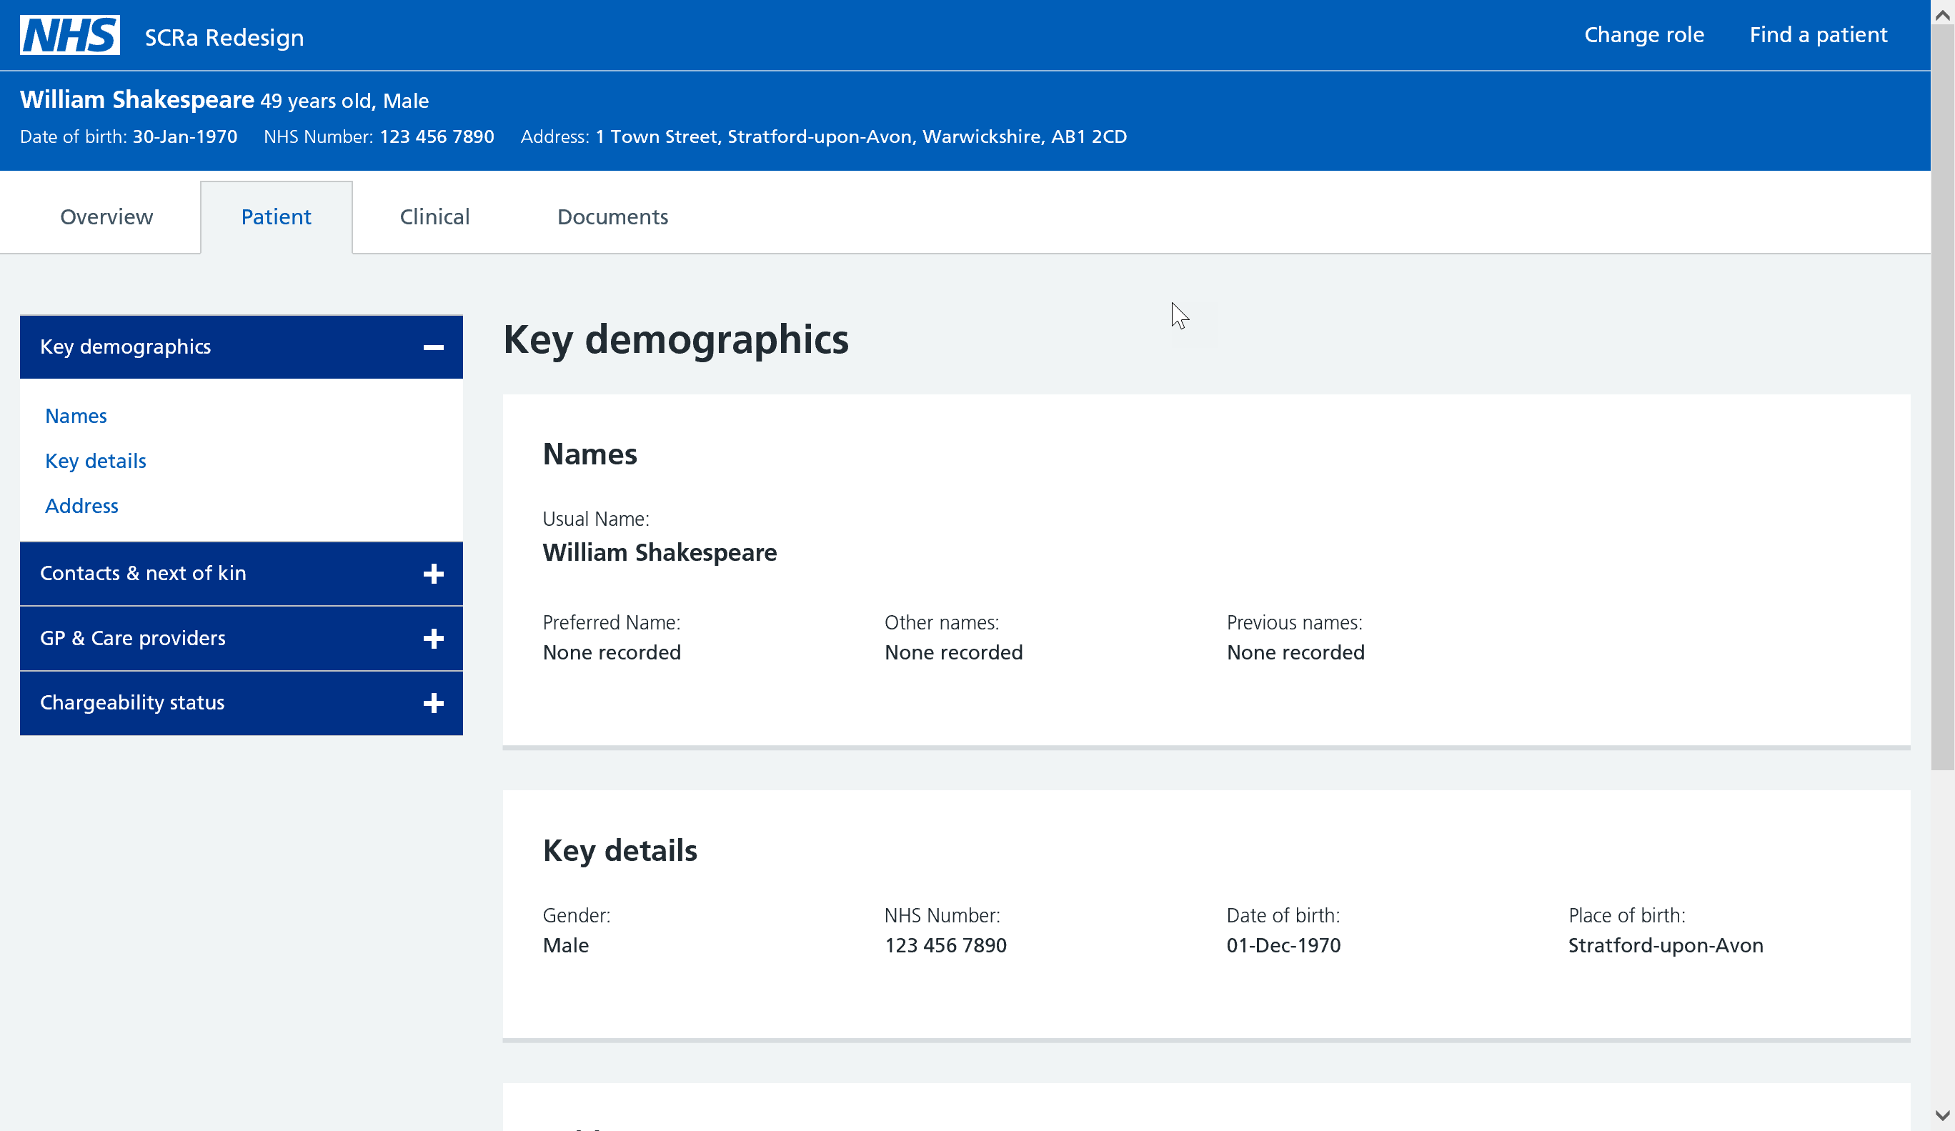

Slide 30
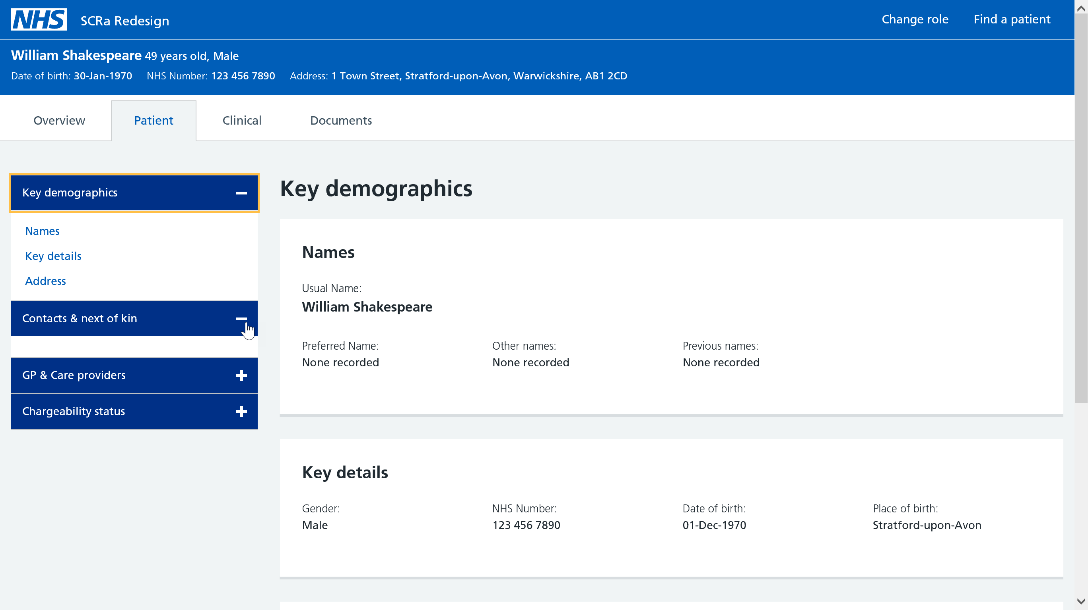

Slide 31
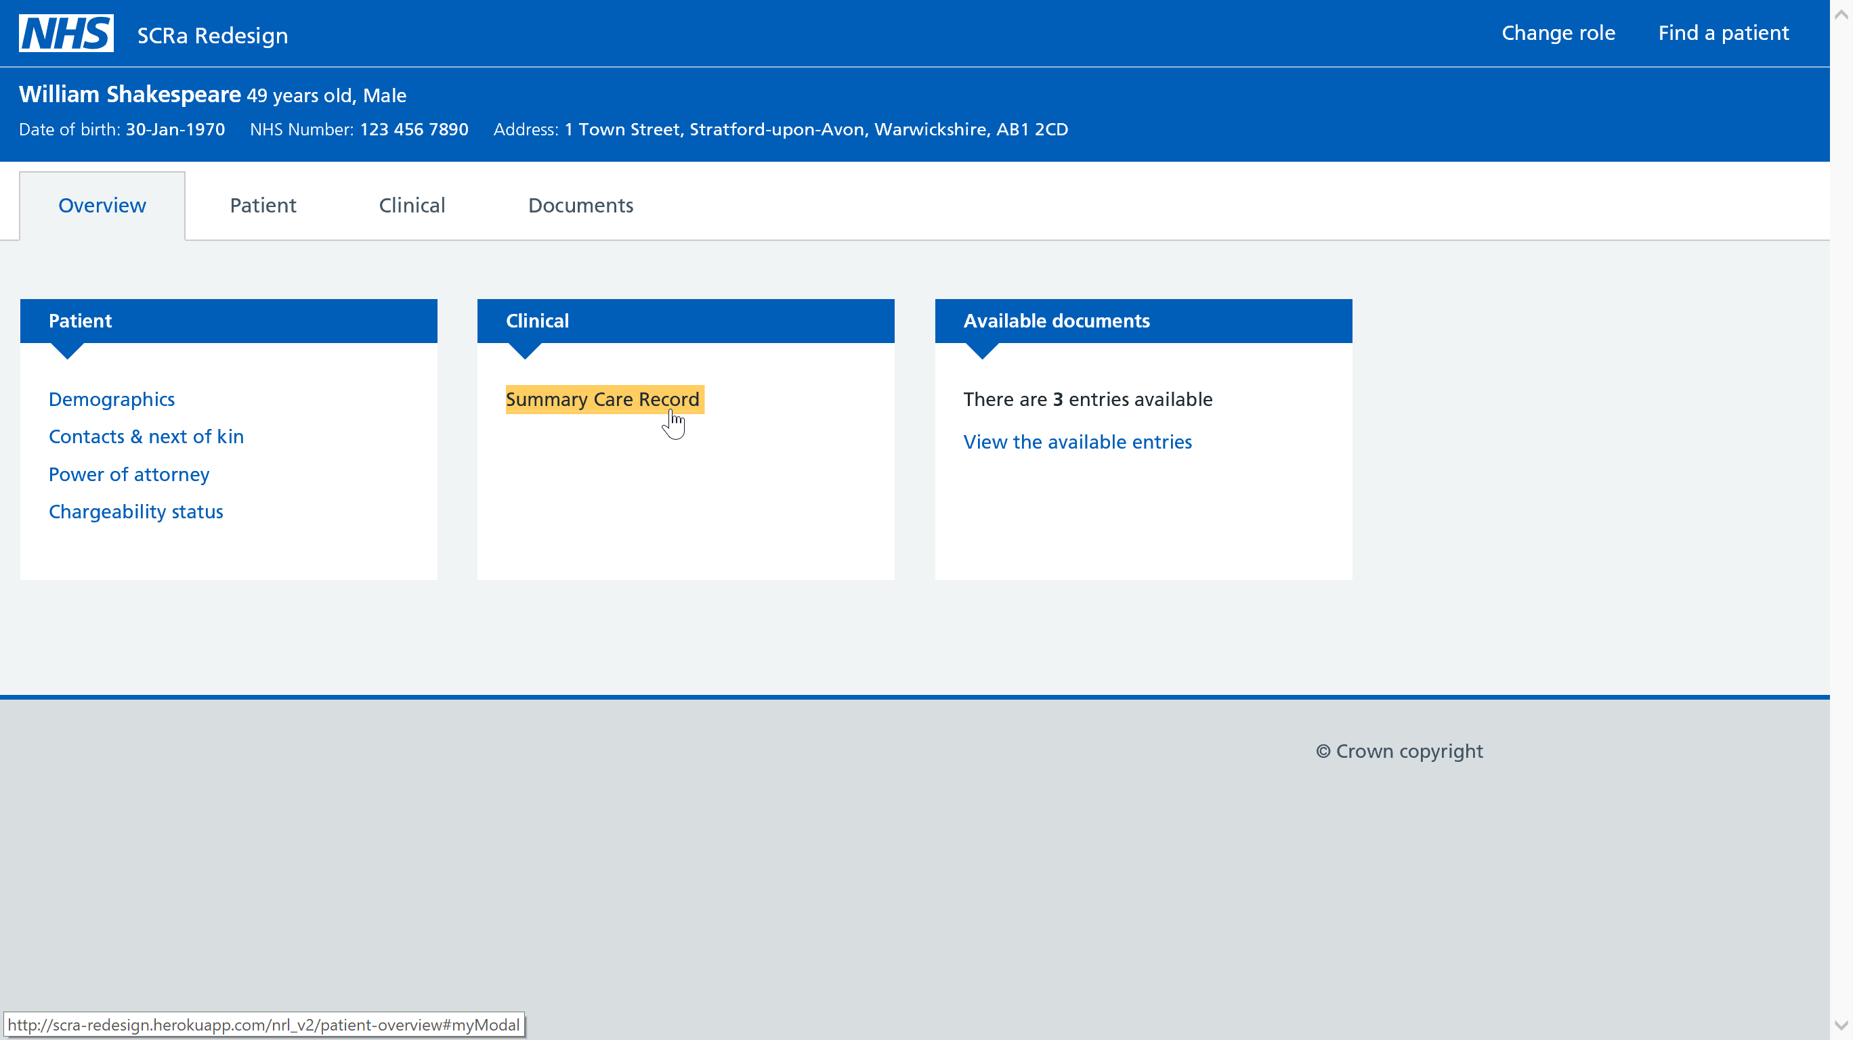

Slide 32
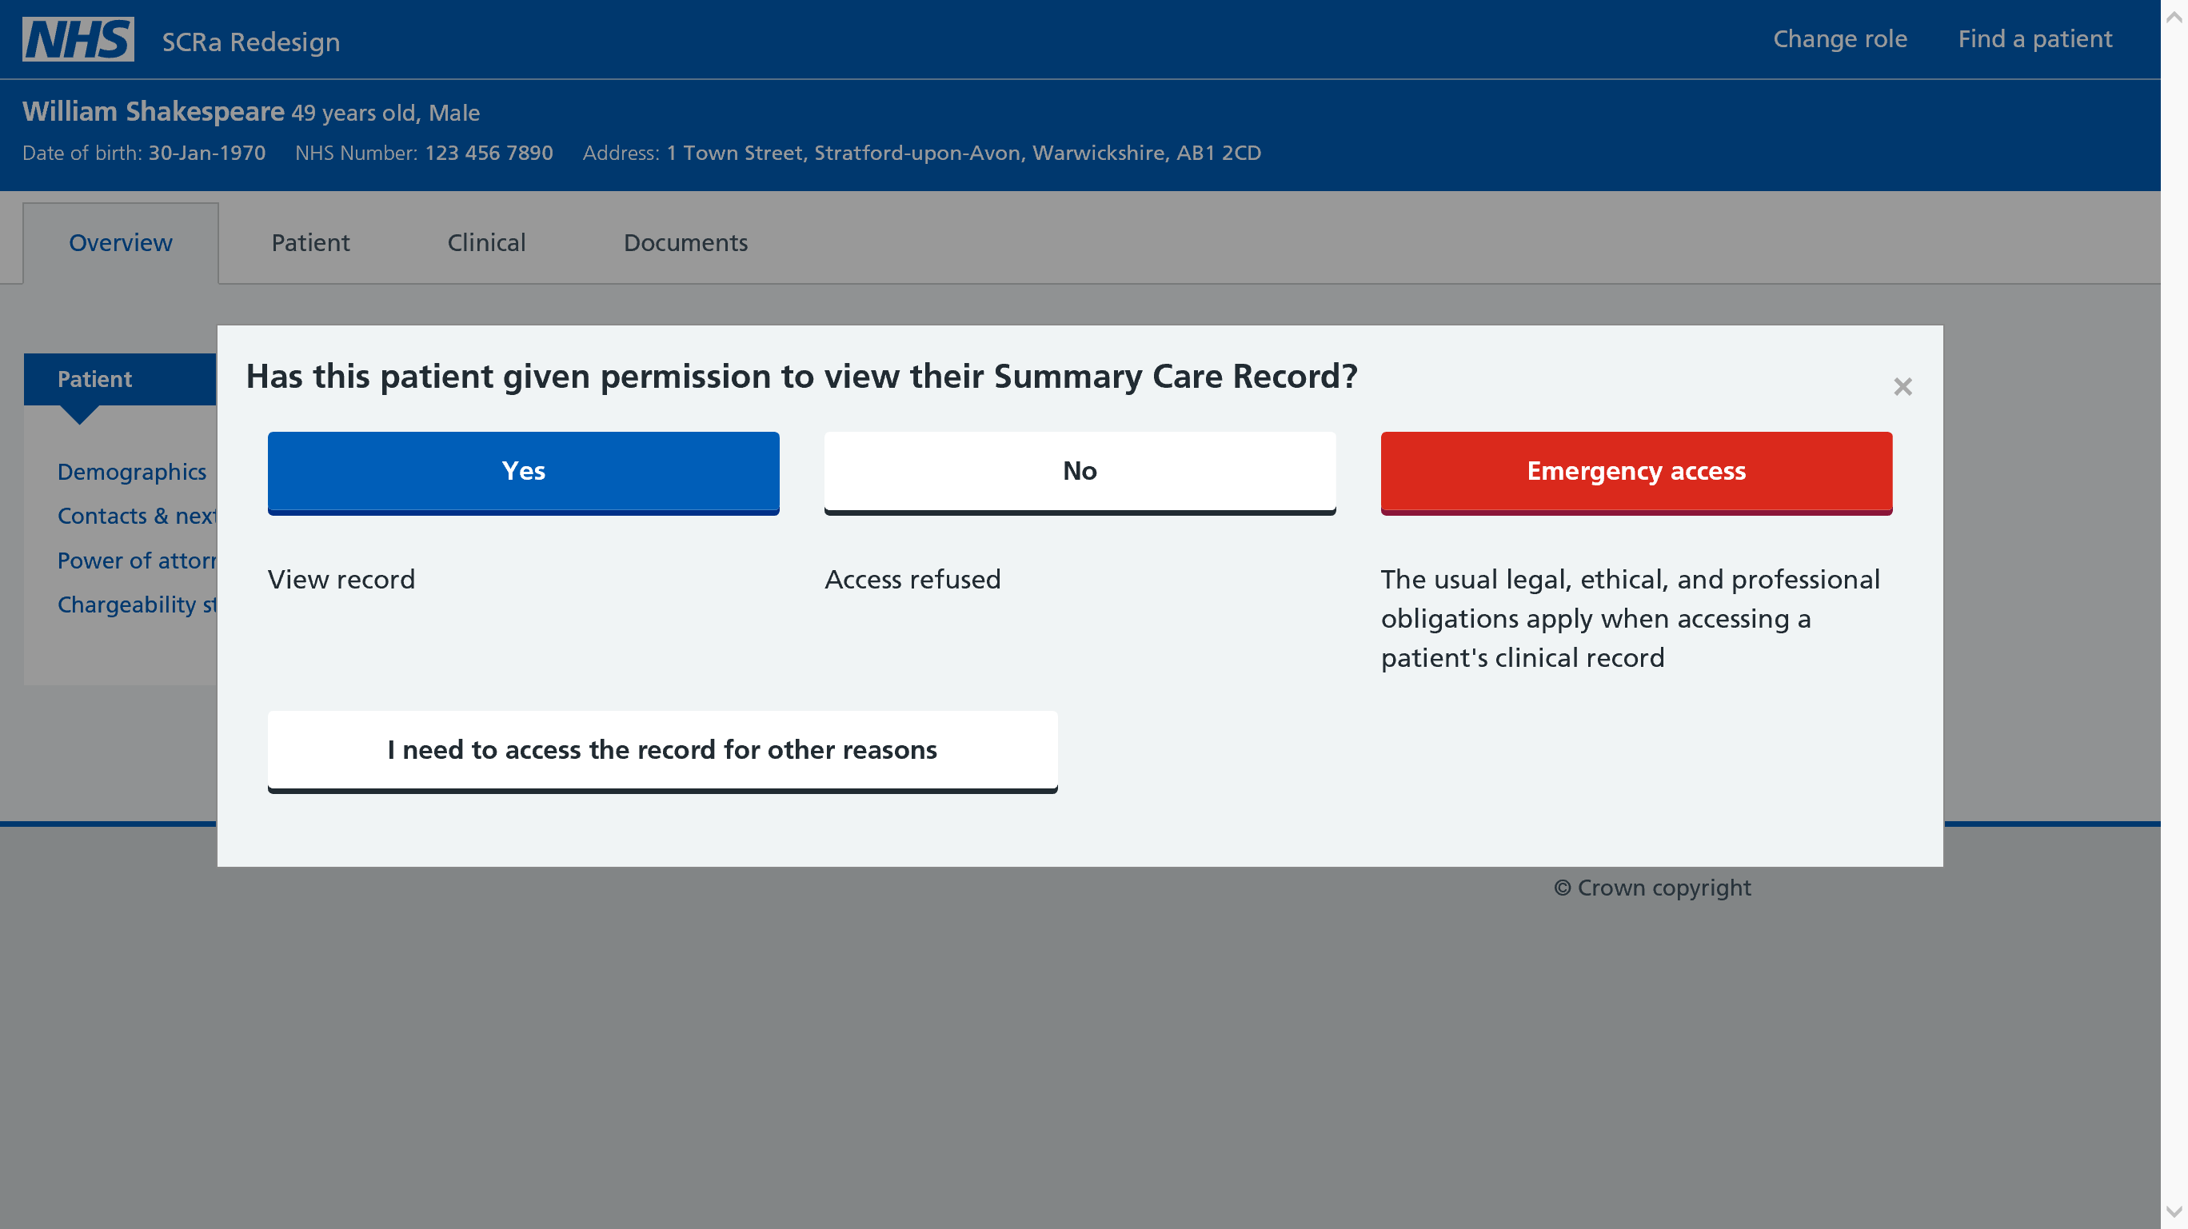

Slide 33
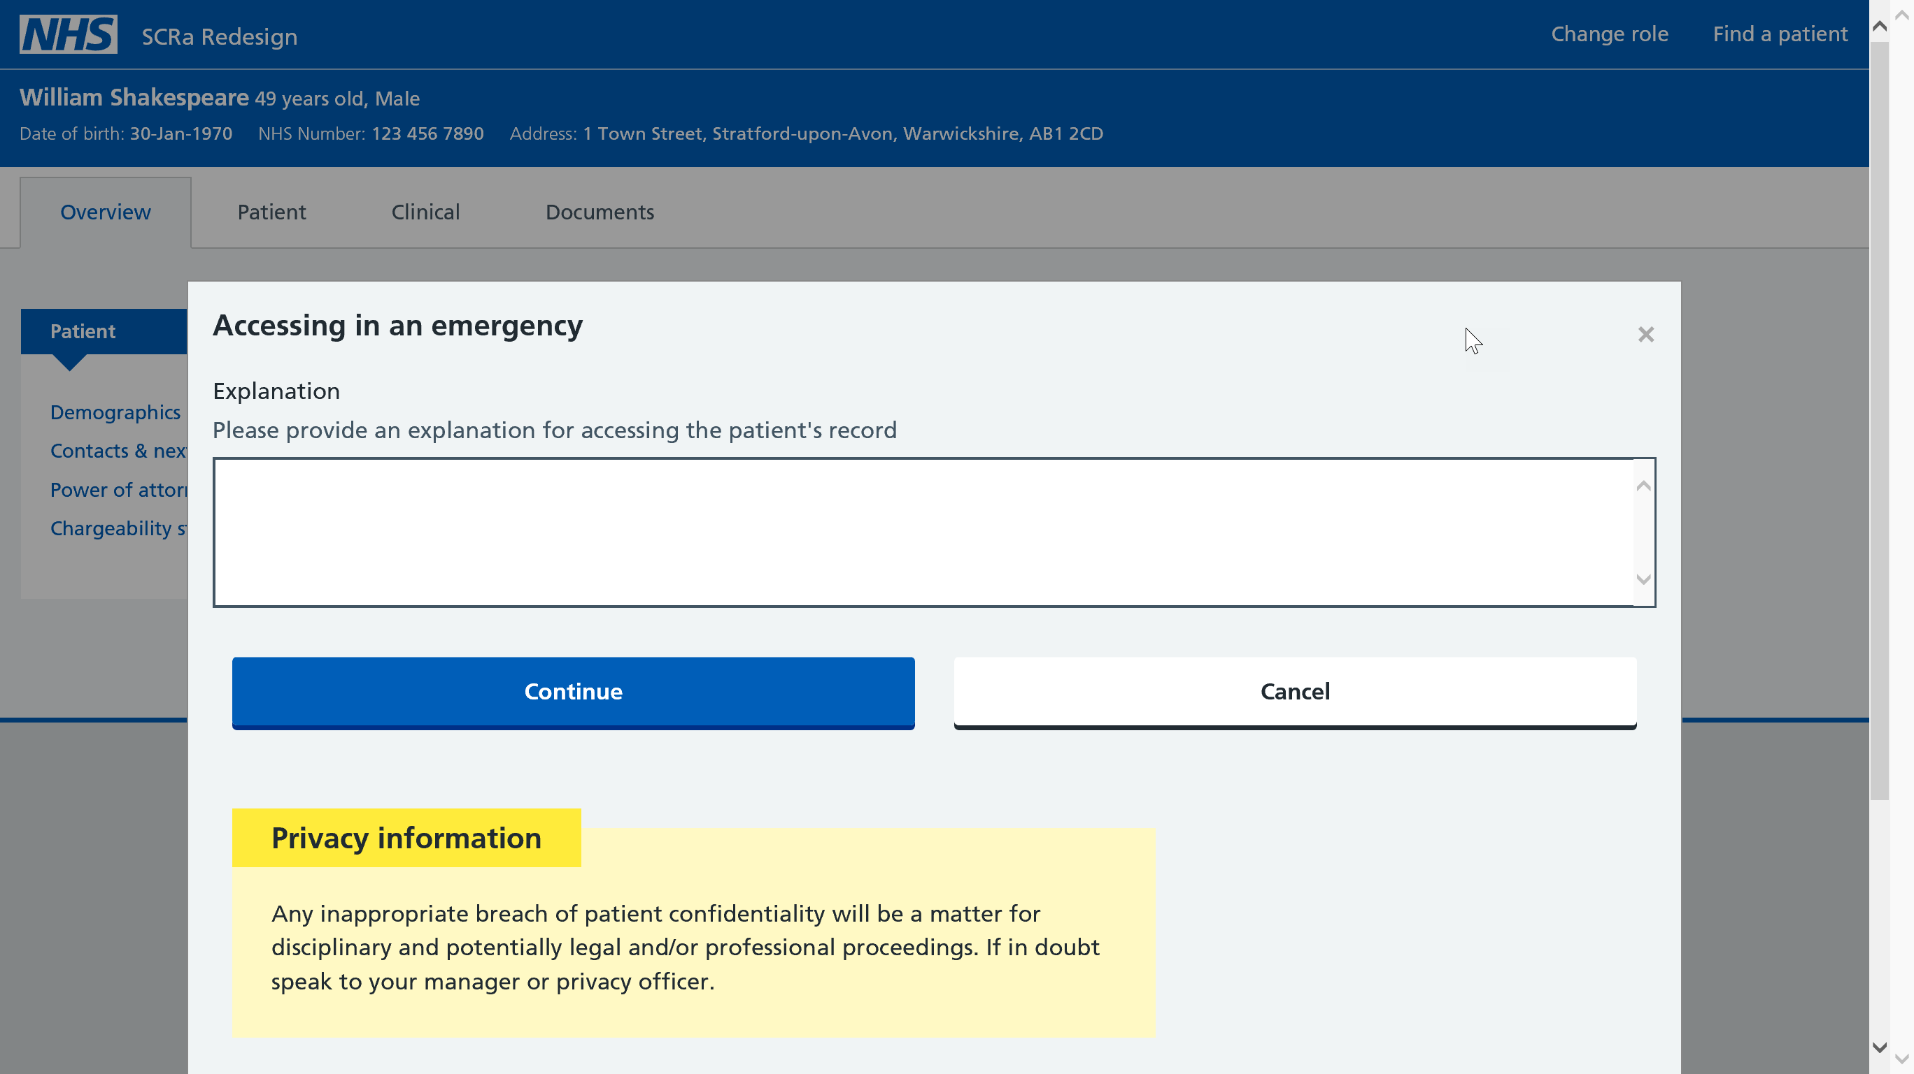

Slide 34
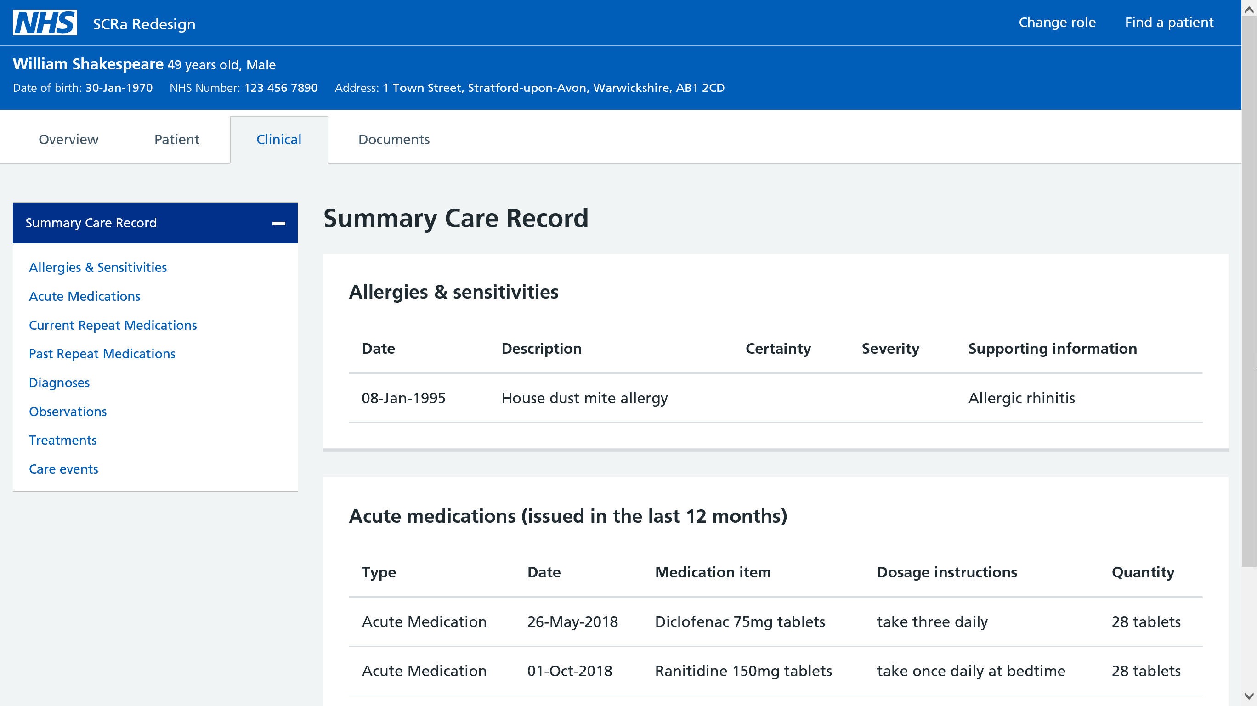

Slide 35
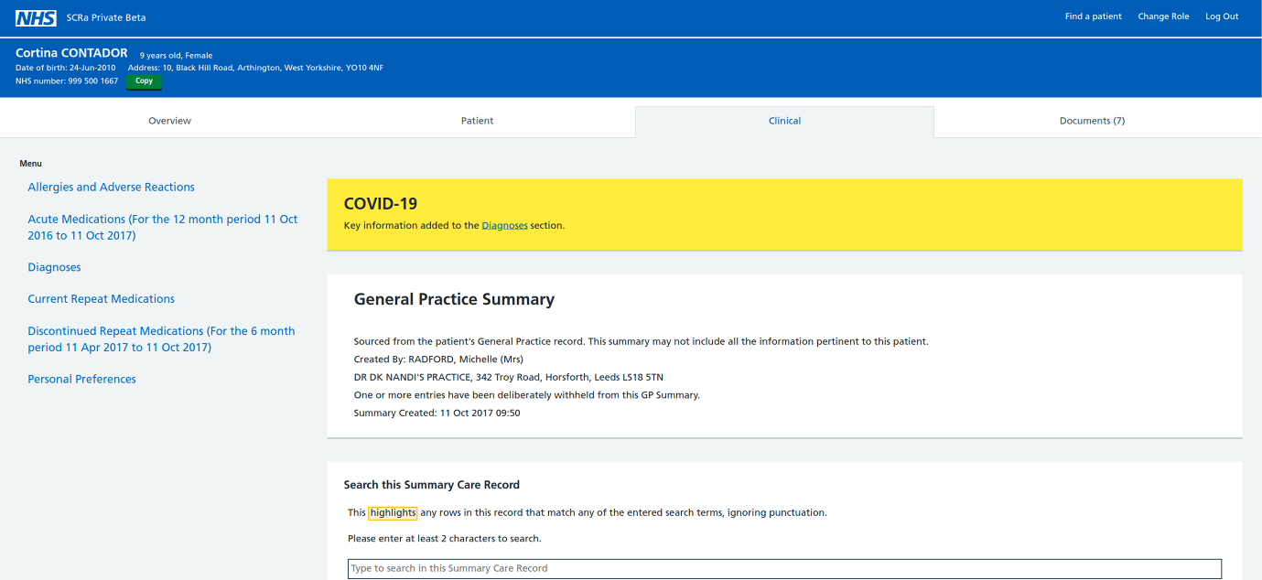
NEW - Covid-19 information ‘call out’ (within SCR) 1.
Notes:
https://digital.nhs.uk/services/summary-care-records-scr/coronavirus-covid-19-message-in-scr

Slide 36
NEW - Covid-19 information ‘call out’ (within SCR) 2.
This development of Covid-19 ‘call out box’ to SCR, shows a key information banner being available in SCRa, 1-click and SCRa Private Beta products to alert an SCR viewer to the presence of COVID-19 information with regards to 'Confirmed' and 'Suspected' cases.
The ‘call out’ will refer to the SCR sections of ‘Investigation Results’ or ‘Clinical Observations and Findings’ depending on supplier system creating the SCR.
It should be noted that the information on the SCR and the Shielded Patient flag visible on SCRa may sometimes show different information. The SCR is updated by the GP record as changes are made whereas the Shielded Patient flag is updated by additional data sources and through a different mechanism.

Slide 37
Important note on viewing older SCRs
Static HTML Issue
Any SCR with the last update prior to the 7th October 2017 will not render in the newly platformed SCRa.
If a view of an older SCR is attempted the user will receive a message saying the SCR can not be rendered in the mobile solution. If the user requires this information, please contact the clinical hub.
If SCRs are not seen on regular basis please feedback to liveservices.operations@nhs.net.
Background
Currently this is around 30% of the SCRs held on the NHS Spine, but this number is organically decreasing due to patient regularly visiting their practice.

Slide 38

Information Governance Controls
When viewing SCRs, organisations are responsible for the security of SCR accesses.
Primarily, this is done through a mechanism of alerts which are visible to the local privacy officer.
The privacy officer will regularly view the alerts to ensure that all accesses are appropriate.
Alerts are triggered at two points:
When an individual confirms a legitimate relationship to view a patients’ SCR [YES].
If the emergency access option is used to override the permission to view. [Emergency Access]
More information available here; https://digital.nhs.uk/summary-care-records/information-governance

Slide 39
Useful Resources
SCR NHS Digital Home
Viewing SCRs & Scope
SCR Governance
NHS Spine Portal Link https://portal.national.ncrs.nhs.uk/portal/dt
SCR e-Learning http://www.e-lfh.org.uk/programmes/summary-care-records
SCR Private Beta https://digital.nhs.uk/services/summary-care-record-application-private-beta
NRL https://digital.nhs.uk/services/national-record-locator or nrls@nhs.net
Operations Team contacts liveservices.operations@nhs.net | scr.comms@nhs.net

